Slide 1


Theory +Economic Survey Vol.2 + Vol.1 + Budget 2016
1.Banking Finance
6.HRD
2.Budget-Fiscal Policy
3.BoP
4.Sectors of Economy
5.Infra
V2C2-Pub.Fin; V1C3-JAM
V2C3-Monetary mgmt+FI
V2C4-External sector
V2C5-Price,Agri.; V2C6,7
V2C8-Paris Summit, Energy
V2C9-Social infra.
V1C4-Agri ; V1C9-Fertilizer
V1C5-mother-child
V1C6-bounties; V1C7-Fiscal Cap
V1C8-PTA
V1C2-Chakravy; V1C10-Labour
V1C11-Powering 1 India
B1. Financial Sector Reforms
B2. Fiscal Discipline
B3. Tax Reforms; B4. Ease of
B5. Agro: 2x farmer income
B6. Rural infra-employment
B7. Infrastructure
B8. Social Sector & healthcare
B9. Education, Skills, Jobs
V2C1- Chakravyuh challenge
V1C1- Twin Balancesheet
IYB:7-Commerce

Slide 2

Pre-requisites understanding
BoP
Current, Capital, BoP Crisis, Forex reserve
Exchange Rate
China Yuan devaluation, Stock market crash
Convertibility
Fixed, floating, managed float
Devaluation, depreciation
Capital, Current Account; SS Tarapore
Foreign Trade Policy-2015
GIFT City, IFSC
Org.
WTO, IMF, World Bank
Self Study
“L3” Series
“L6” Series
ML5/P4 (China Crash)

Slide 3
Fast Revision + Survey 2015: v2c4, v1c8
BoP #; ECB
Gold Schemes
IMF Reforms
WTO Nairobi
Mauritius DTAA
E-Commerce

Slide 4
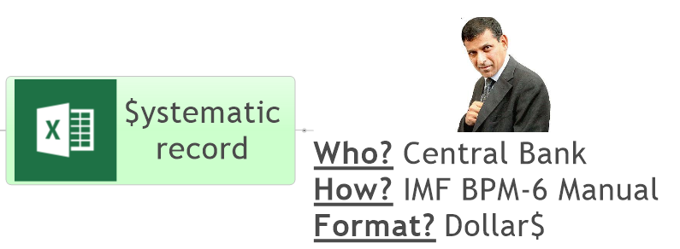



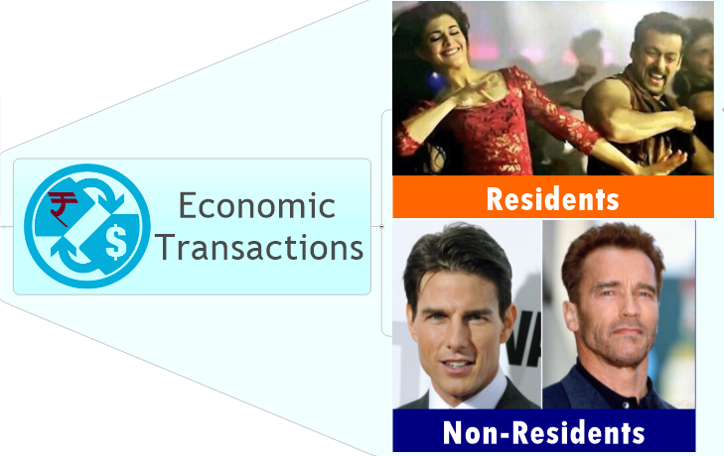
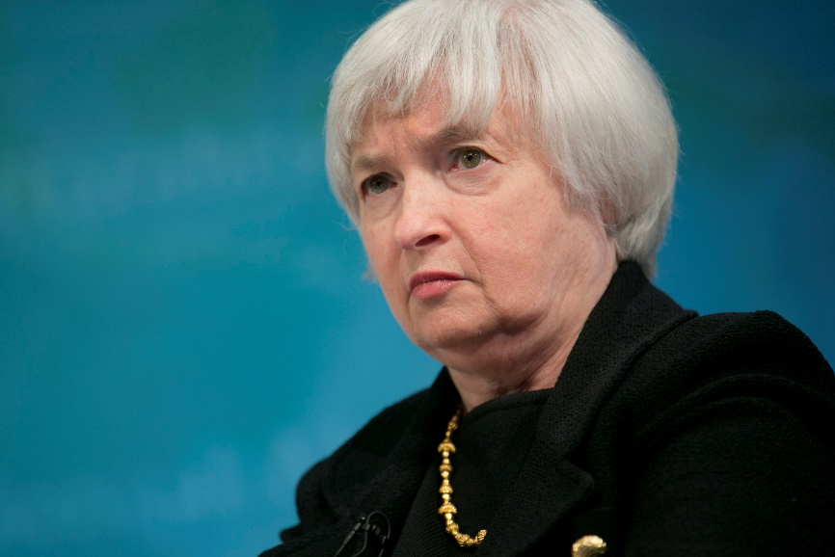
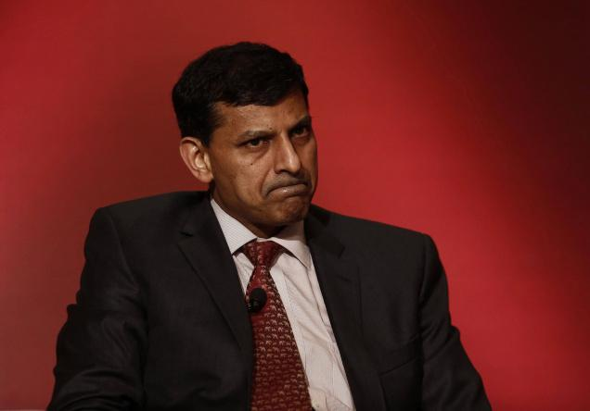

What is Balance of Payment?
World’s NET BoP = ZERO
DEBIT
CREDIT

Slide 5
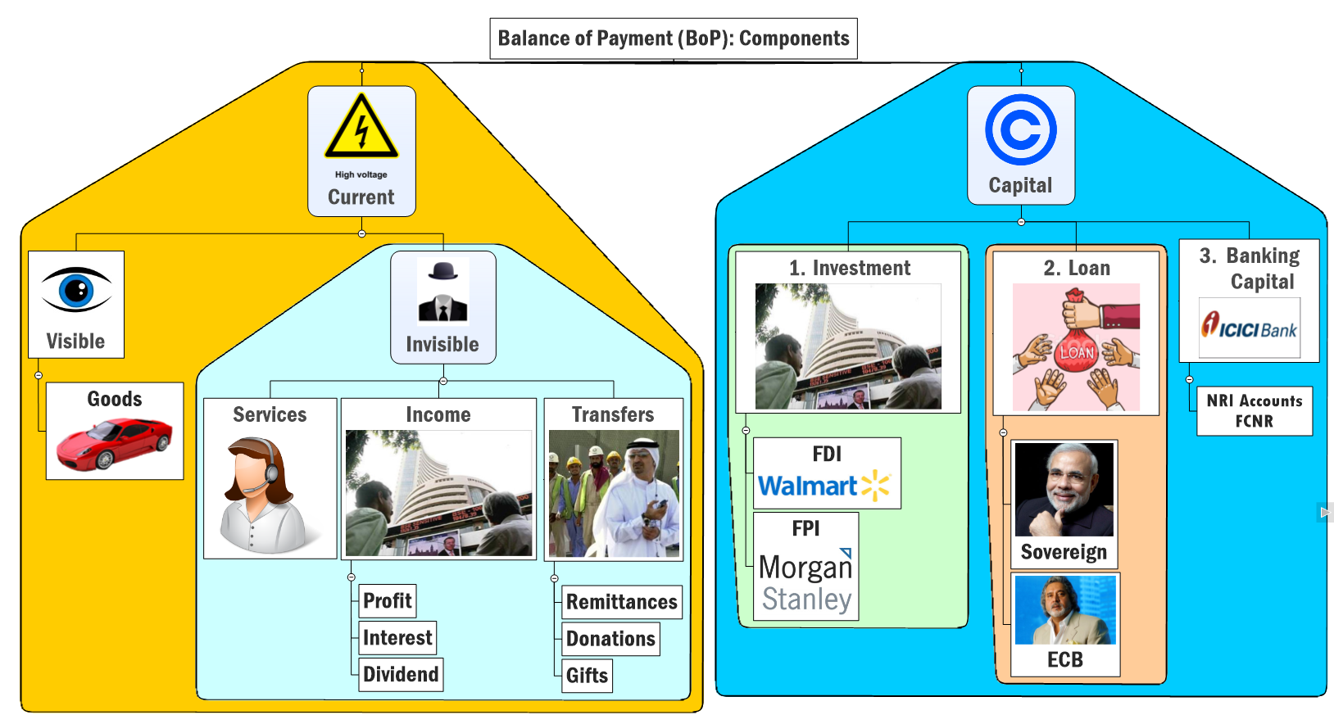
IMPORT (-) Debit
EXPORT (+) Credit
IF BoT is
+ve = Trade Surplus (EX>I’M)
-ve=Trade Deficit (IM>EX)
Balance of Trade (BoT)

Slide 6
Import: Top-5 items (US#1, India#12 largest importer)
Crude
Gold & Gems
Chem & Fert.
Electronics
Machinery Capital goods
Year 2014
Crude
Gold & Gems
Electronics
Machinery
Chem & Fert.
Coal not included
Year 2015 (Apr-Dec)
Notes:
6th number minerals and ores- will have coal etc.

Slide 7
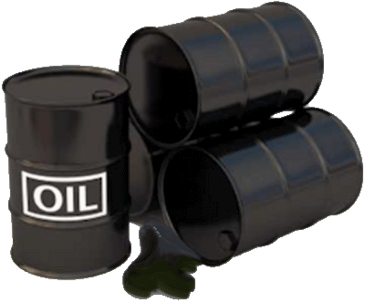
Import-2015: Highest Negative growths (overall -16%)
Declined Oil Prices

Slide 8
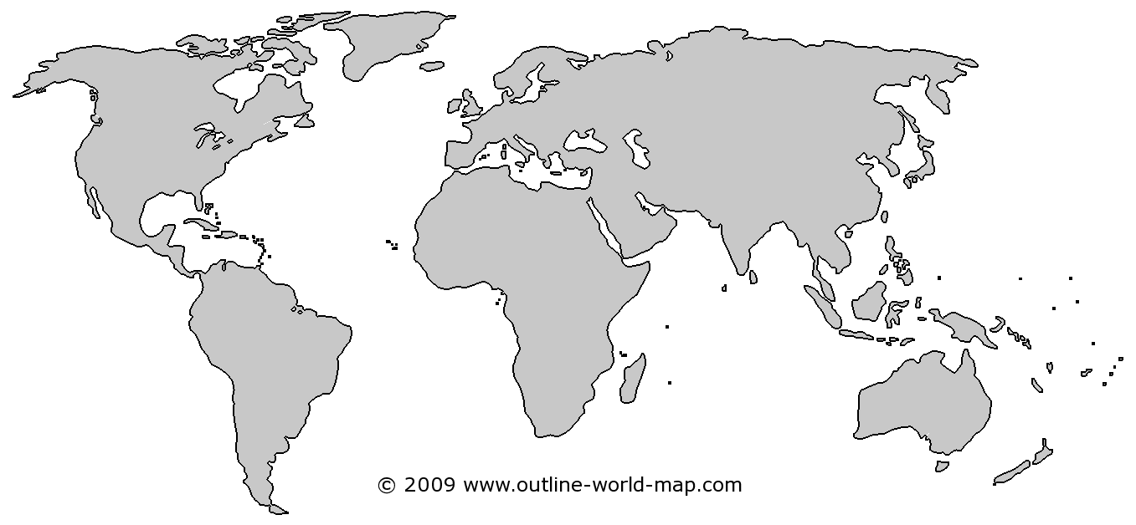
Why oil price fall in 2014-15
EU, China
growth▼
US: Shale Gas, Oil ▲
OPEC Oligopoly ▼
Saudi did not cut production so to hurt Iran
Notes:
from >100 per barrel to <50$
China, EU Growth▼=oil demand ▼
US oil + shale gas production ▲
OPEC oligopoly ▼, S.Arabia did not ▼ production
Survey predicts: $60-65 / barrel, so, inflation and CAD will be moderate for 2015-16

Slide 9
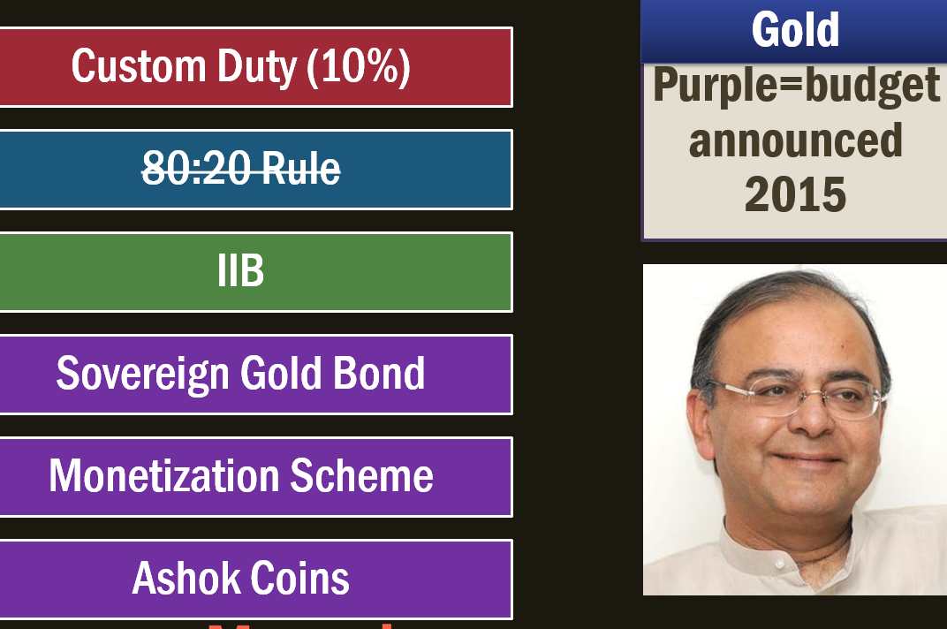
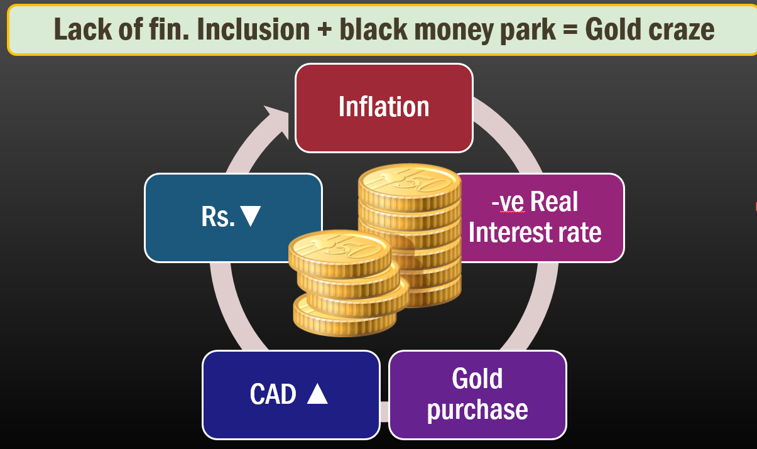

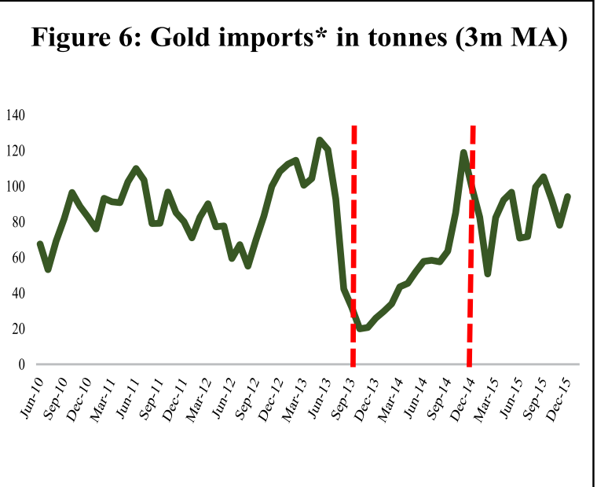
Gold import: Self study: L6/P1
Why is Gold craze bad?
Steps done to reduce gold demand

Slide 10

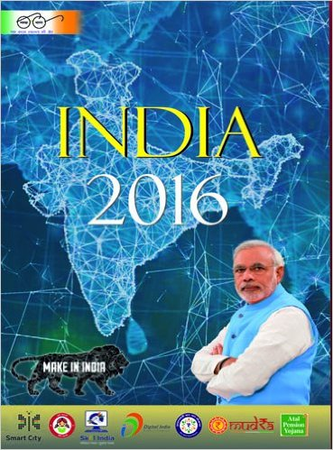

Government borrowing (IYB-2016, Page 345)
Treasury Bills / Short term
Only States: 14 days
Both through “auction”
Dated Securities / Long term
365 days or above
Sovereign Gold bond (8 years)
Union: 91, 182, 364 days
Budget-2015- launched; Budget-2016 RBI to take measures to ensure retail participation in G-Sec

Slide 11



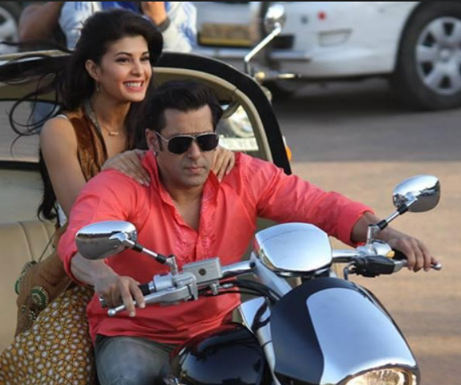
Sovereign Gold Bonds; CGT exempted IF kept till maturity
Issued on Government’s behalf
Sold @banks, post offices
“auction” system
Paper format
KYC yes
RESIDENT
CITIZEN
Minor, Jt.Holdiing, HUF, Charities, Universities
DEMAT format
2 to 500 gms;
Per person per year
2.75% CI half yearly | Tenor: 8 years
Redeem: Rs. price of gold @Maturity
Can be used as loan collateral
To settle losses of Veer 2, Jai Ho 2
Tenor 8 year; Can Exit from 5th Year
Tradable on exchanges = can exit faster
‘gold reserve fund’ to cover the risk of gold price movement.
Notes:
Gold ETF: mutual fund, no interest.
With every issue Government can change…interest rate.
Eligible investors include individuals, HUFs, trusts, universities, charitable institutions, etc.
RBI issues them on govt's behalf
Denomination: in grams
Only for Resident Indians (KYC=Gold)
Available in both in demat and paper form.
Min. 2 gm; Max. 500 gms per person per year
Interest: 2.75% compounded half yearly
Tenor: 8 years, can exit from 5th year
Redemption: Rs. Price @time of maturity
Capital gains tax: exempted
Two rounds so far- ~4000kg worth gold bonds sold @~1kcr.

Slide 12

Sovereign gold bond
Criticism
Interest too low, Lock in period too high.
Counter: can be used Loan collateral
KVP, PoRD, NSC etc offer better return
Counter: Gold price @Maturity
But, There may be a risk of capital Loss if the market price of gold declines. (gms remain same but can’t redeem in “gold”)

Slide 13


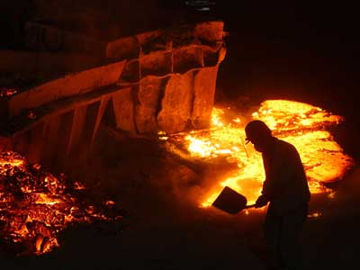
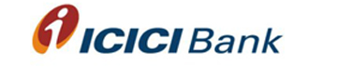
Gold Monetization Scheme: CGT exempt yes
RESIDENT
CITIZEN
Min. Deposit 30gm
Max. NA
BIS certified Collection, Purity Testing Centres (CPTC)
REFINERS
Tri-partite agreement
Term | Year | Interest | Redeem
Short | 1-3 | 2.25% | Cash / gold
Medium | 5-7 | 2.5% | Cash
Long | 12-15 | 2.5 | Cash
Gold Savings Account
Denomination in GRAMS
Notes:
Bureau of Indian standards (BIS) came into existence, through an act of parliament dated 26 November 1986, on 1 April 1987, with a broadened scope and more powers taking over the staff, assets, liabilities and functions of erstwhile ISI. Through this change over, the government envisaged building a climate for quality culture and consciousness and greater participation of consumers in formulation and implementation of national standards.
The Bureau is a Body Corporate consisting of 25 members representing both Central and State governments, Members of Parliament, industry, scientific and research institutions, consumer organizations and professional bodies; with Union Minister of Consumer Affairs, Food and Public Distribution as its President and with Minister of State for Consumer Affairs, Food and Public Distribution as its Vice-President.
Customers deposit gold to CPTC
certified by Bureau of Indian Standards
Min. 30gm, max- NA [So far >1k kg. gold mobilized]
Gold savings account in Bank.
denomination in grams of gold
short-term: 1-3 years (2.25% interest)- RDM Cash/Gold
medium-term: 5-7 years (2.5% interest)- RDM Cash
long-term: 12-15 years (2.5% interest)- RDM Cash
CPTCs transfer the gold to the refiners.
The banks will have a tripartite / Bipartite Legal Agreement with refiners and CPTCs.
Tax exemption are same as those available under GDS 1999.

Slide 14
▼Gold consumption
CGT benefit to gold investment schemes
1% excise on non-silver jewelry
Cash payment >2 lakh for goods/services: addl. 1% TCS
Budget 2016

Slide 15
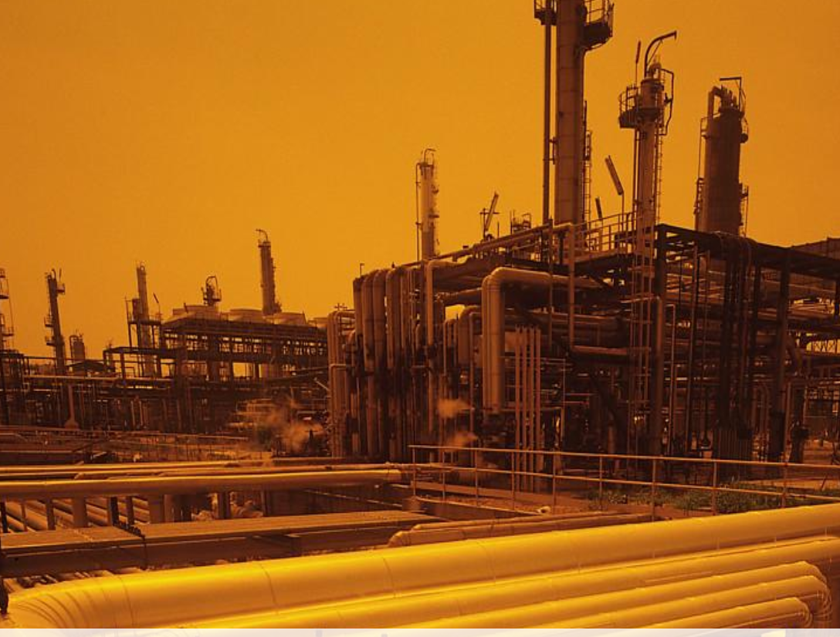
National Capital Goods Policy, 2016
What Target-2025?
Jobs: 3 cr. (direct-indirect)
How?
Production: Rs. 7.5 Lcr.
Net-Exporter
Mandatory standards to reduce sub-std. imports
Marketing Assistance
R&D Tech. Development Fund; Skill development
Who?
Department of Heavy industry under Min. of heavy industries and publ. enterprises.

Slide 16
Export- Top-5 items (China #1, India #19 largest exporter)
Petro
Gems
Textile
Chem
Agri
Year 2014
Gems
Textile
Petro
Chem
Agri
Tie
12.2%
Year 2015 (Apr-Dec)

Slide 17
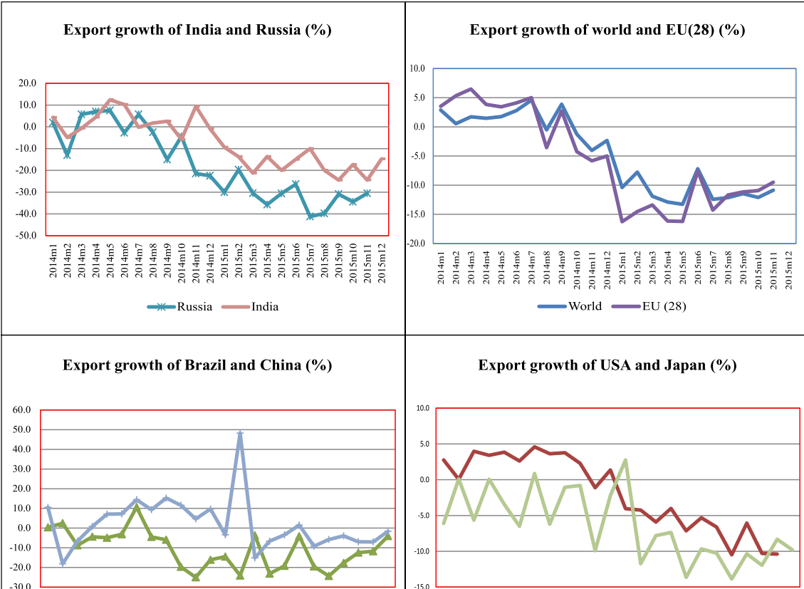
Export-2015: Highest Negative growths (overall -18%)
El Nino, Drought
SC Ban
China crash
Crude price, China crash: ML5/P4

Slide 18
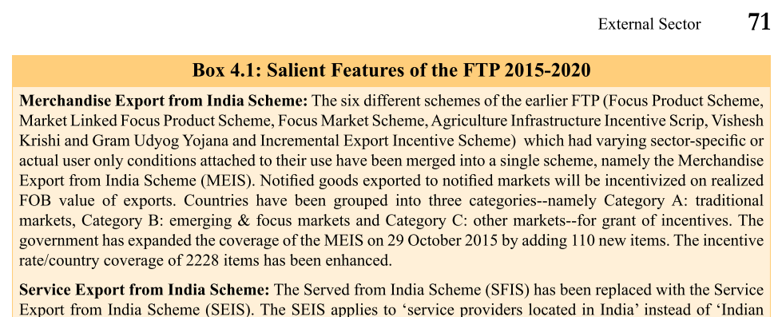
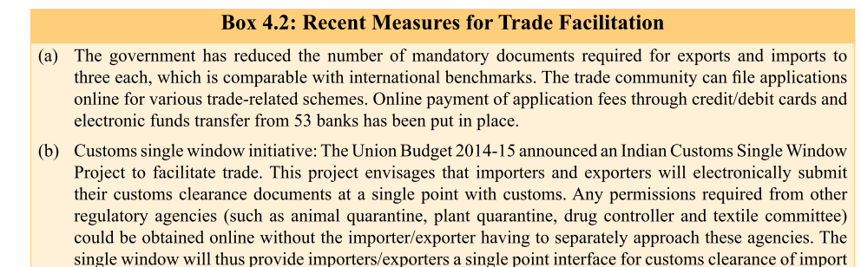
FTP-2015 L6/P2

Slide 19
Special zones
1965: Asia’s first EPZ @Kandla
2000: SEZ policy: 329/415 notified
2015: Budget- GIFT city to be promoted as IFSC (L6/P8)

Slide 20
India’s trade relation- IYB-2016; Page159-160
Export
USA
UAE
Hong Kong
China
Saudi
Import
China
Saudi
UAE
Switzerland
USA

Slide 21
IMPORT (-) Debit
EXPORT (+) Credit
IF BoT is
+ve = Trade Surplus (EX>I’M)
-ve=Trade Deficit (IM>EX)
Balance of Trade (BoT)

Slide 22
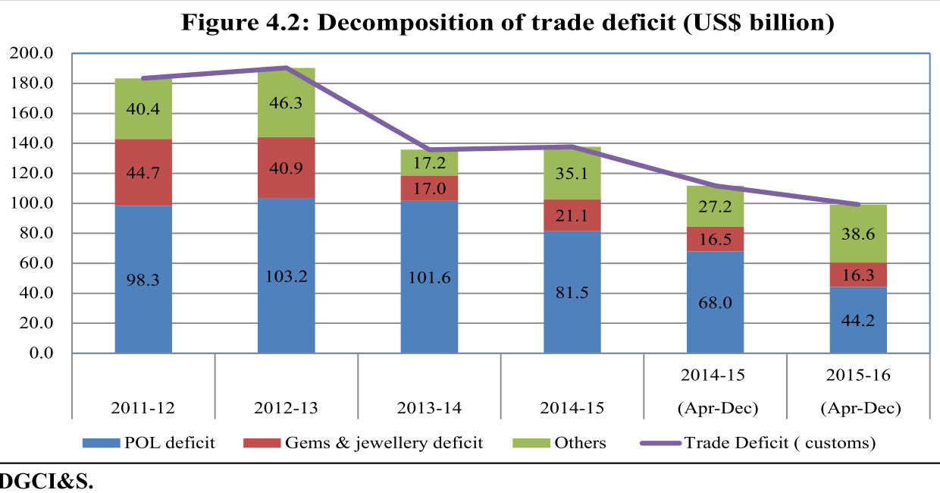
Trade deficit: declining or moderating
Crude price down
Measures to reduce gold consumption

Slide 23
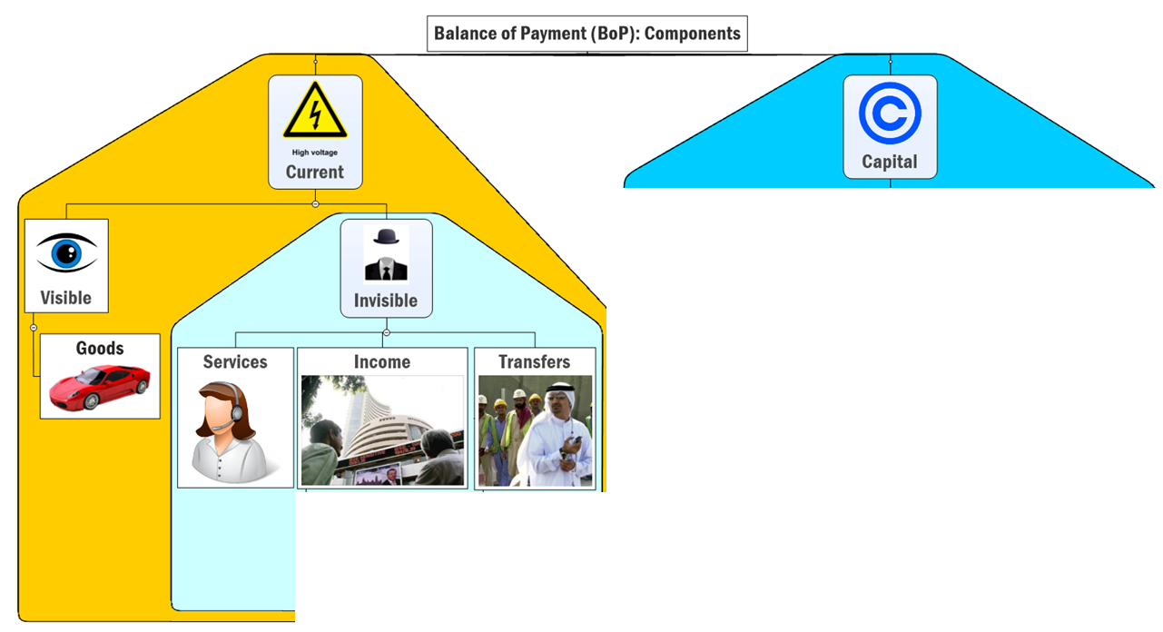
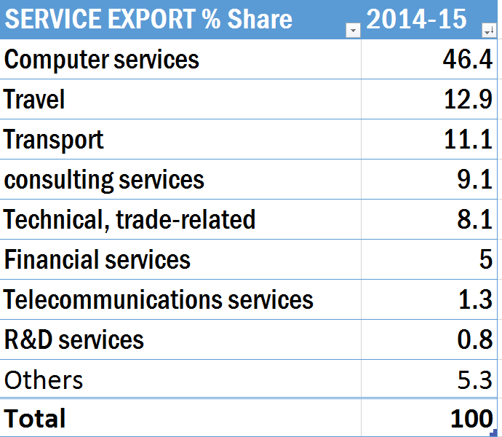
TRADE DEFICIT
Trade in Goods & services

Slide 24


Slide 25
Current Account DEFICIT
चालू खाता घाटा
TRADE DEFICIT
World Bank report in 2015, Dec.
Data- 2014
Crude oil price ▼=> Remittance ▼, not yet
But survey fears pink slips if this continues.

Slide 26
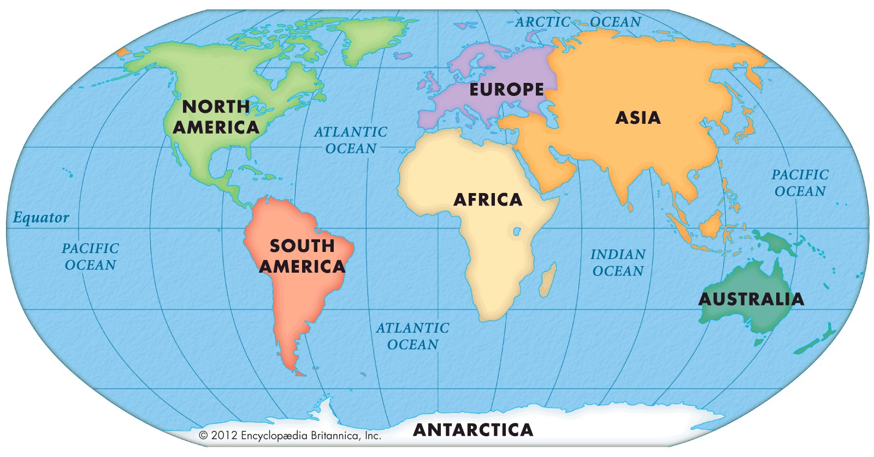
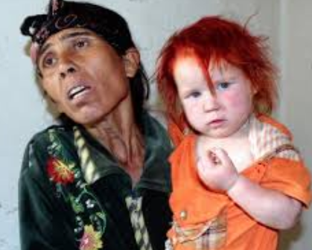

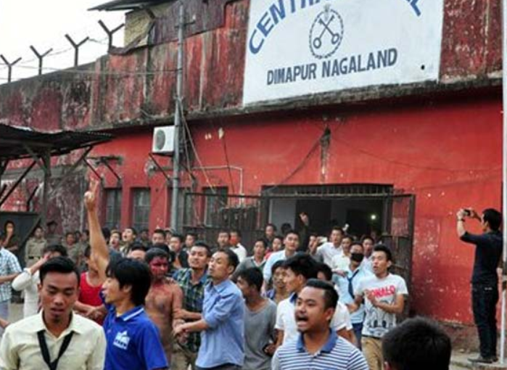
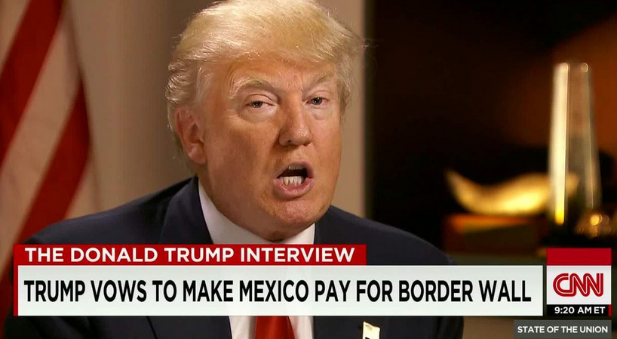
Largest migration corridors- World Bank (2013)
#3: Ukraine-Russia
Roma migrants selling children
In Germany
Crimea
#1: Mexico- US
#2: Bangla-India
EU Refugee crisis
Notes:
4,000-strong mob thrashed a 35-year-old alleged rapist to death after dragging him out of a high security jail in Nagaland’s Dimapur town.

Slide 27
ESSAY
“History in its broadest aspect is a record of man's migrations from one environment to another.”
Physical
Socio-Religious
Economic
Political
…..

Slide 28
Calculating current account deficit (CAD)
Current Account DEFICIT
चालू खाता घाटा
TRADE DEFICIT

Slide 29
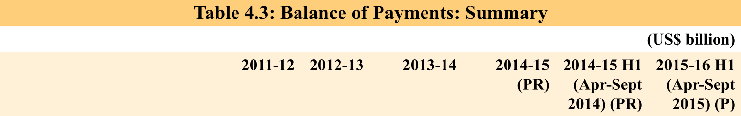
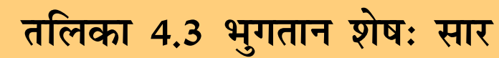
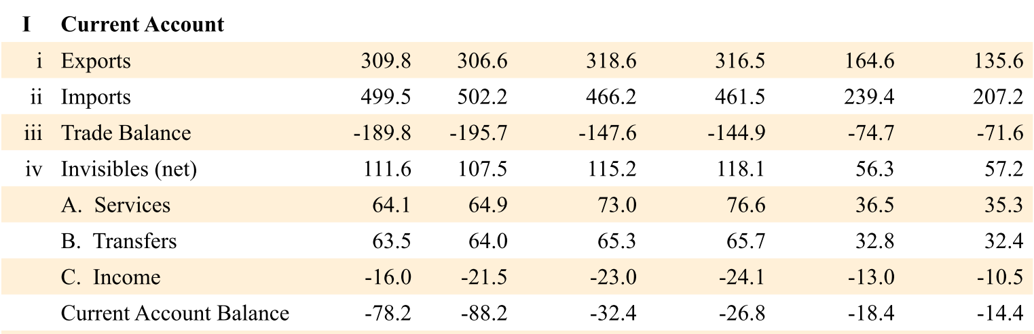
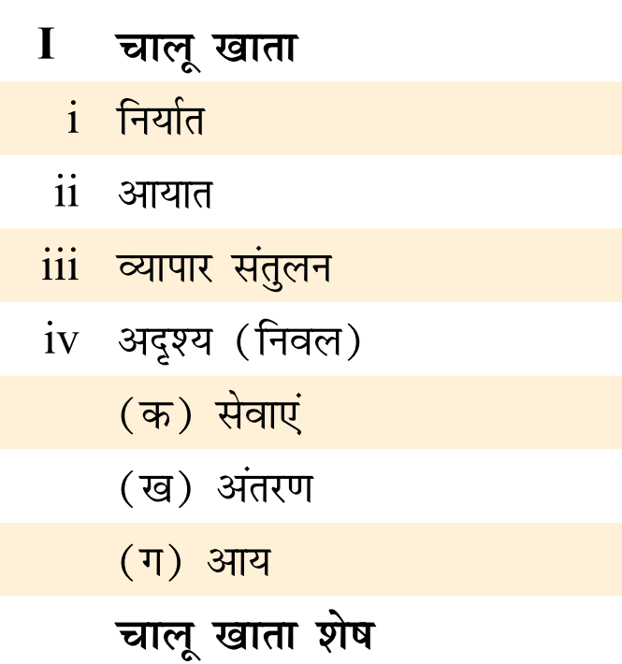

Slide 30
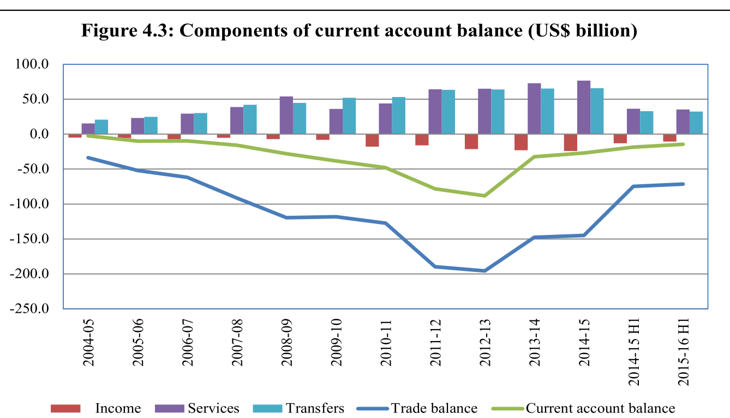

Slide 31
Current Account Deficit has declined
Twin deficit = high level of current account deficit + high level of fiscal deficit

Slide 32


Fast Revision + Survey 2015: v2c4, v1c8
BoP #; ECB
Gold Schemes
IMF Reforms
WTO Nairobi
Mauritius DTAA
E-Commerce

Slide 33
Current Account DEFICIT
चालू खाता घाटा
TRADE DEFICIT
2015-Apr-Sept.
2015-Apr-Sept.

Slide 34


Foreign investment
FPI
FDI
>10 Equity Investment
ADR/GDR: American/ Global Depository Receipts
FII, QFI, FVCI (Venture), NRI
Foreign Currency Convertible Bonds or FCCBs
If Bond (Debt) converted to Shares (Equity) >10% then here
Notes:
Colors of the logo

Slide 35


Composite Cap in all except…..
FPI: Max. 24%
FPI: Max. 49%
Notes:
Axis, yes bank
Bank, Defense
Defense: overall 49%, FPI max. 24%
Pvt. Banking: overall 74%, FPI max 49%
Others
Composite cap
NFBC 100% (any composition of FDI+FPI)

Slide 36
Upto 100% Equity Foreign investment permitted in
Agri, Animal
Agriculture (Tea- Government route)
Manufacturing; Industrial Parks; Railway-infra
Mining, coal
Housing, construction*
Oil gas exploration
Airport Greenfield, brownfield; helicopter, Courier
Pharma Green field; Brownfield; ,Medical devices
NBFC, ARC –SARFAESI; White-label ATM
Sci-magazine, journals
Wholesale trading, single brand Retail, B2B-Ecomm, Market place-Ecomm

Slide 37
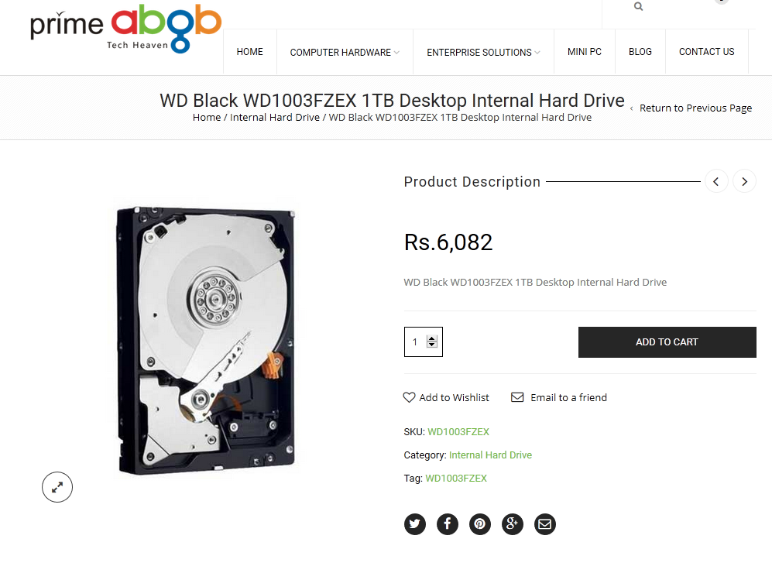
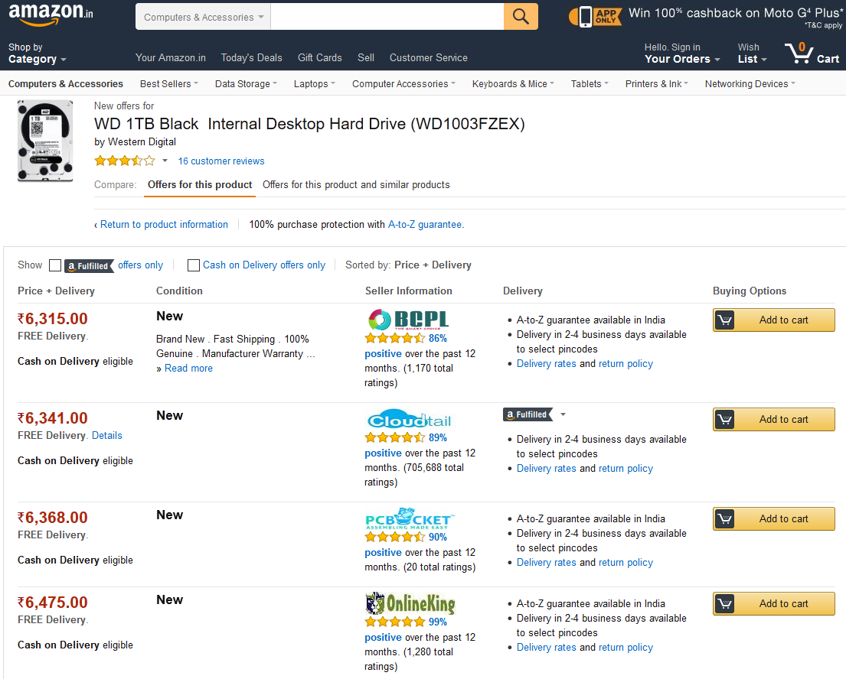

FDI in E-commerce; WEF 2016
Have to maintain “Level playing field”
FDI prohibited
100% automatic FDI permitted
Mustn’t allow >25% sale from individual vendor
Inventory based E-commerce
Company owns inventory of goods, sells to consumers directly
Marketplace based E-commerce
Company provides IT platform to facilitate deal between buyer and seller
Notes:
Criticism
What if 25% norm violated by multiple shell firms?
Norms require company to make ‘level playing’ field among sellers; But what if one of them is giving deep discount?

Slide 38
Upto 74% Equity Foreign investment permitted in
Private Banks (FPI Max 49%)
Broadcasting: DTH, Mobile TV, Satellite
Credit info. companies

Slide 39

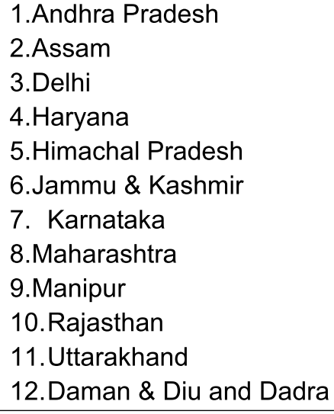
Upto 51% Equity Foreign investment permitted in
Multi-brand Retail
50 million in backend infra
30% Local procurement from small industries, farmer coop,
In 10 lakh pop / Census-2011
Only selected States/UT

Slide 40
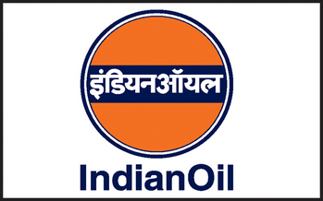

Upto 49% Equity Foreign investment permitted in
PSU-Petro Refine; Power-exchange
Defense (FPI-24%); private security agencies
Cable
Insurance; Pension; Commodity exchange
Airlines

Slide 41
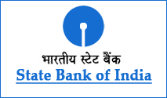
Upto 26% Equity Foreign investment permitted in
FM Radio
Print Media
Public Sector Banks- 20% MAX

Slide 42

FDI PROHIBITED IN
Lottery, Chit funds, Nidhi fund
Betting, Gambling, Tobacco
Real estate business
Atomic energy.
Railway transport (Metro permit)
Farmhouse
Tobacco industry
B2C E-commerce :Inventory based

Slide 43
FDI: Sector wise- last 15 years trend
Services
Computer Hardware, software
Construction
Telecom
Automobile
Decreasing order
Notes:
Highest services=.

Slide 44
FDI: Destination state wise (last 15 years trend)
Delhi
Haryana
Maharashtra
Karnataka
Tamil Nadu
Gujarat
Andhra Pradesh
Decreasing order
But, mineral rich states like Jharkhand, Bihar, Madhya Pradesh, Chhattisgarh and Odisha not receiving
Notes:
Highest services=.

Slide 45
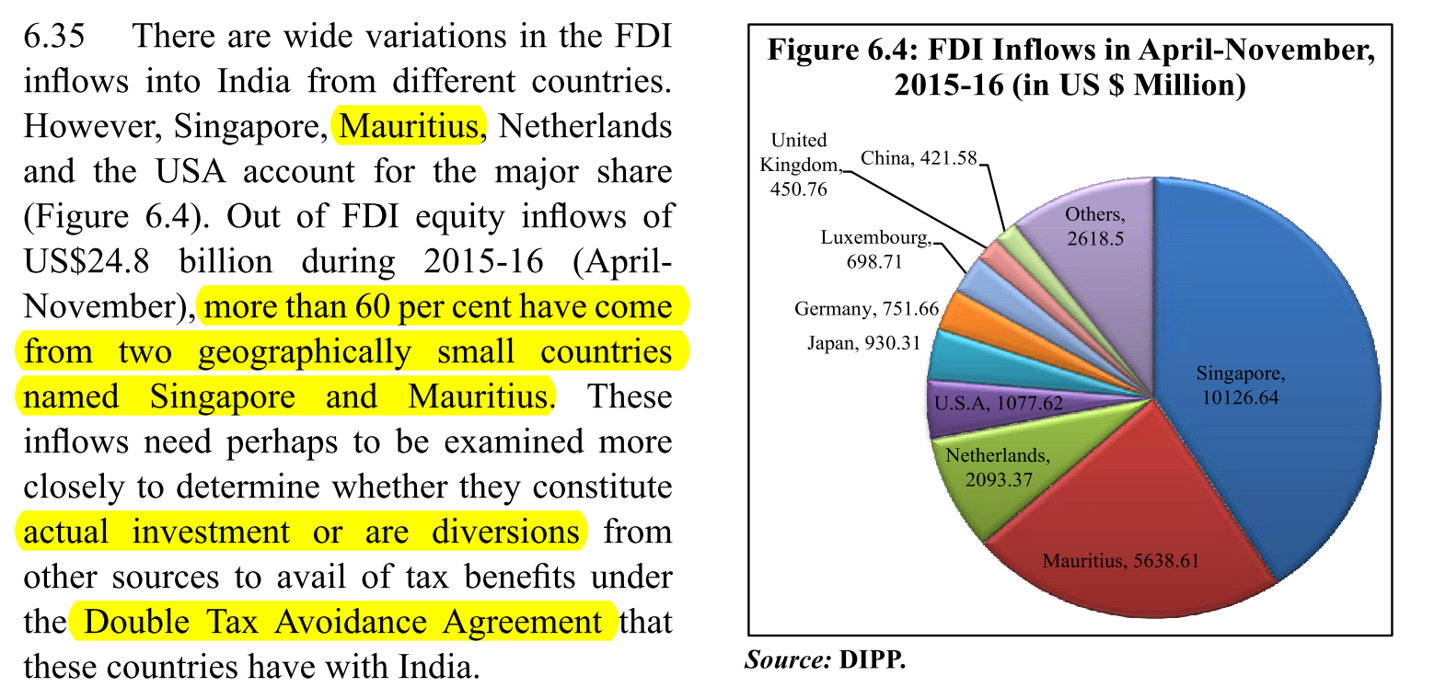
FDI source country wise
3. Netherlands
4. USA
1. Singapore
2. Mauritius
1+2=60% FDI
Survey asks
Govt to investigate “Round Tripping”

Slide 46
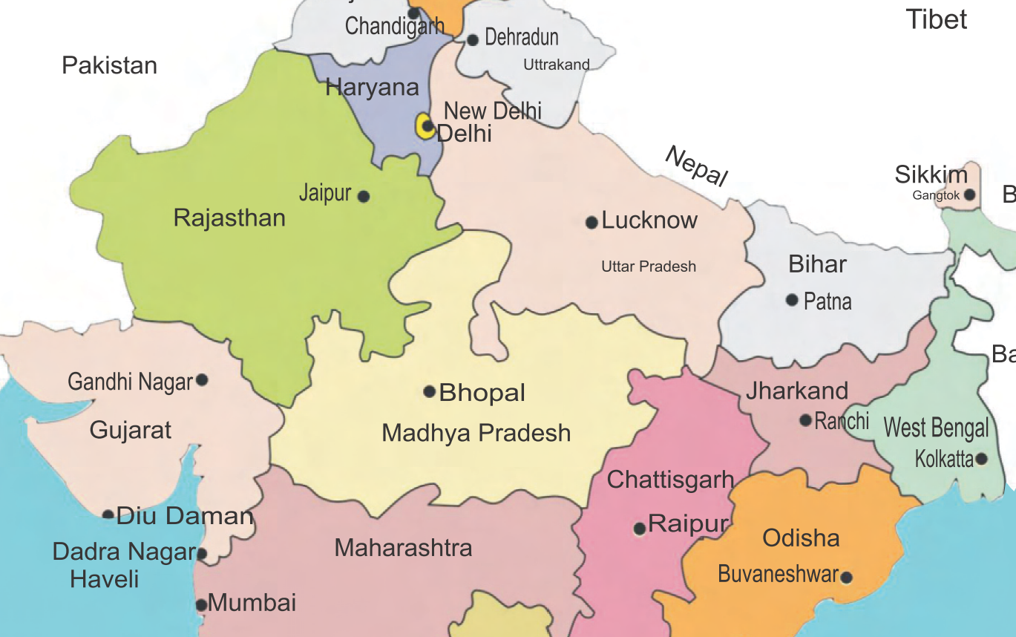




What is Round tripping?
WITHHOLD CGT
& Pay to Govt.

Slide 47



What is round tripping
Send $$ via LRS / Hawala
Open postbox co. in tax haven,
invest back in India
India Singapore DTAA:
CGT exempt till India-Mau. DTAA exempts
Indian Mauritius DTAA
In this case, Mauritius firm getting profit, so only Mauritius can levy CGT
But Mauritius has deleted CGT long time back.

Slide 48
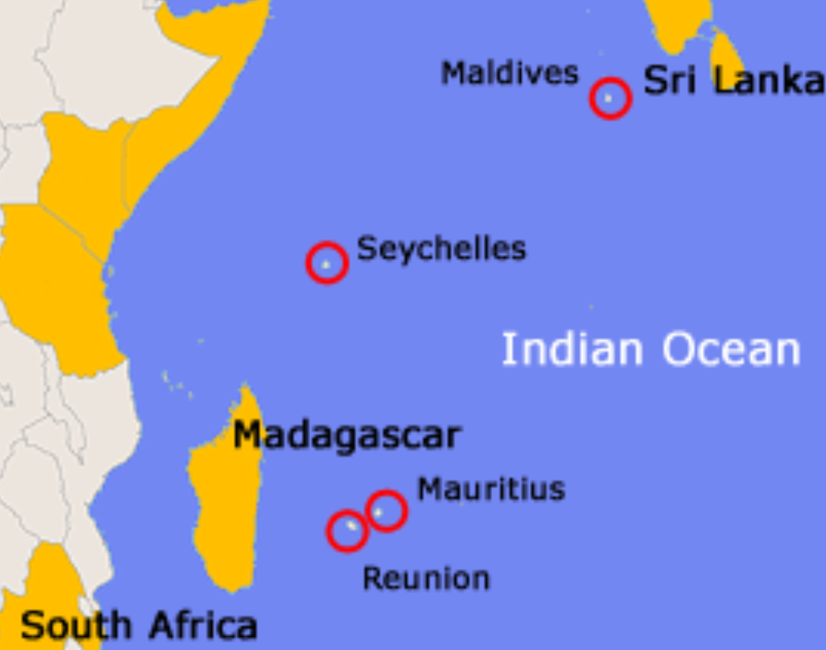
India Mauritius DTAA
1983
Mauritius abolished CGT
DTAA signed
****
2016, May
Amended
Till 31st March 2017
From 1st Apr 2017
Phase wise CGT implement
1st April 2019
Hv2pay CGT just like Indian residents
“Grand-fathering”
CGT N/A even afterwards
GAAR immunity
GAAR Applicable
Capital
Port Loui
Expected surge in FDI, till this date.
Notes:
In 1983, the Indian government had bartered away the nation’s interest by agreeing to a most laughable clause in the agreement-- -the Indian government will not tax the capital gains earned in India by a resident of a Mauritius. And post-haste, the Mauritius government abolished capital gains tax in its country thus playing dog-in-the manger to the hilt (I will not tax and I will not allow you to tax either)
Indo-Mauritius Double Taxation Avoidance Agreement (DTAA) inked at Port Louis, the capital of the island nation on 10 May 2016. .
If I sold shares of an Indian company in an Indian bourse, obviously the resultant profit is an Indian income and the same rule ought to apply to non-residents because as per the source rule of taxation, even a foreigner has to pay tax in India on his Indian income.
to facilitate round-tripping of black money of Indian crooks-- -- Indians buying shell companies in Mauritius and investing in the Indian share market.
An Indian resident acting straight has had to pay tax on short-term capital gains whereas a crook pretending to be a Mauritius resident got away with no tax.
Long term capital gains have been exempt in either case thanks to the exemption conferred by the income tax law on it provided the transaction was consummated in a recognized stock exchange in India.
And from 1 April 2019, they would pay full tax at par with the Indian residents.

Slide 49
Yearbook
What is “Japan PLUS”?
Team consisting of India and Japanese representatives to fast track Japanese investment in India.
It functions under DIPP in Commerce Ministry.
None correct
Both correct
Invest India program = DIPP + FICCI + State Government
Hannover Messe (HM)= trade exhibition fair in Germany

Slide 50
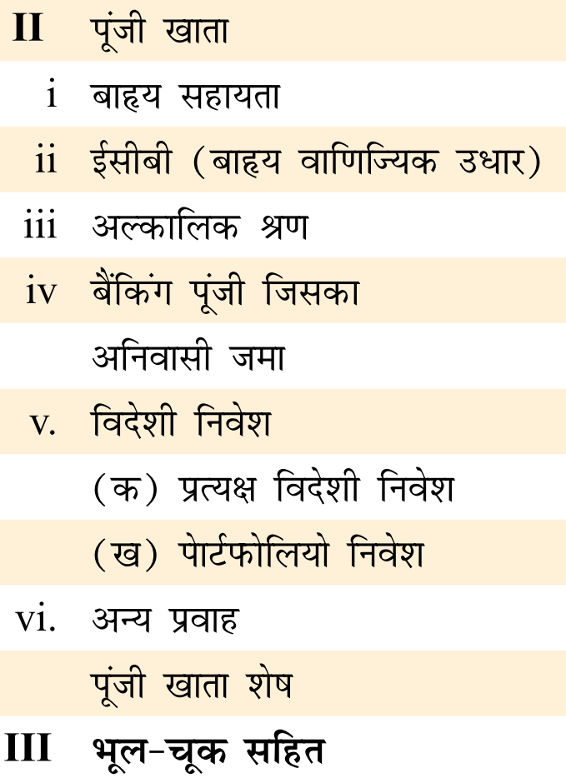
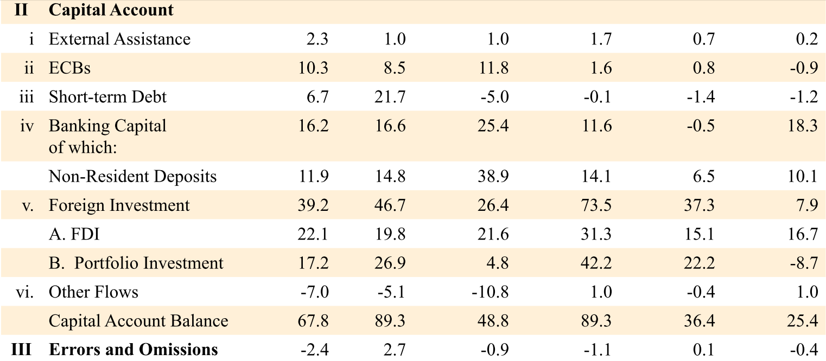
Surplus coming
Running away

Slide 51
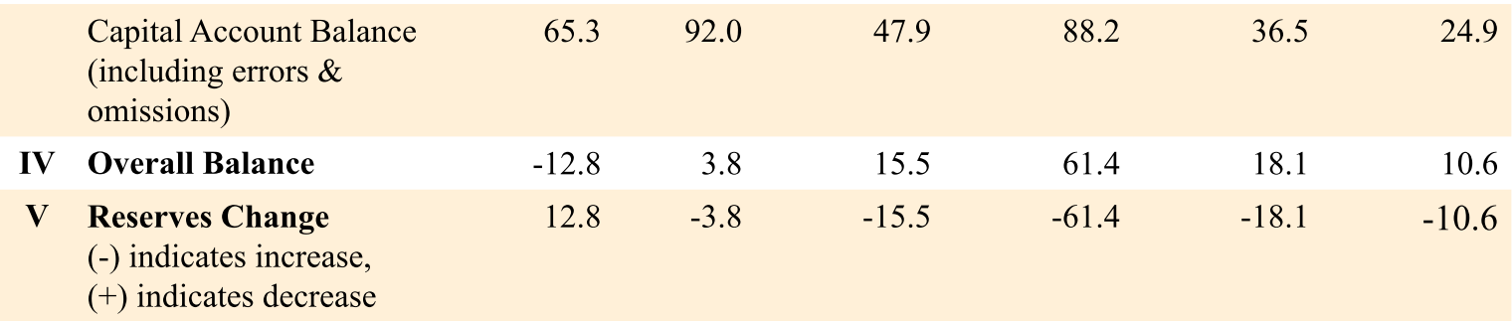
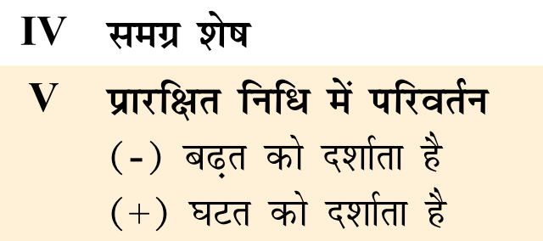

Slide 52

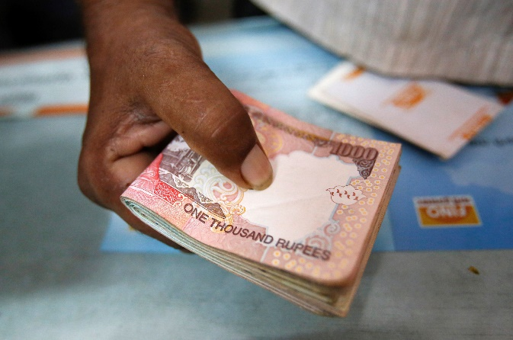
If Balance of Payment is POSITIVE
$1=50Rs.
$1=40Rs.
Bad for Indian exporters

Slide 53
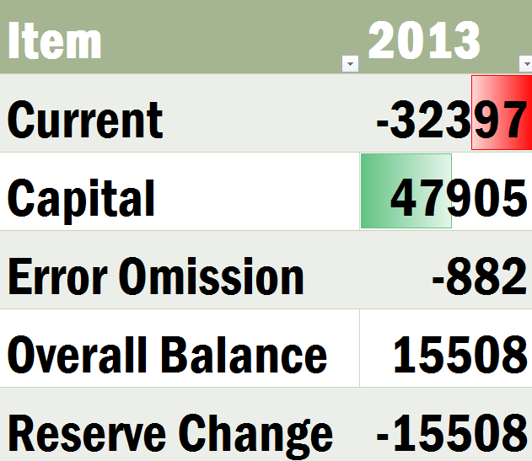

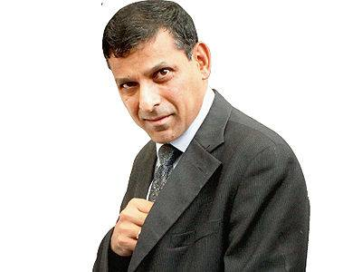
If BoP surplus- RBI should purchase those $$ (Mill.USD)
Balance of Payment ZERO

Slide 55
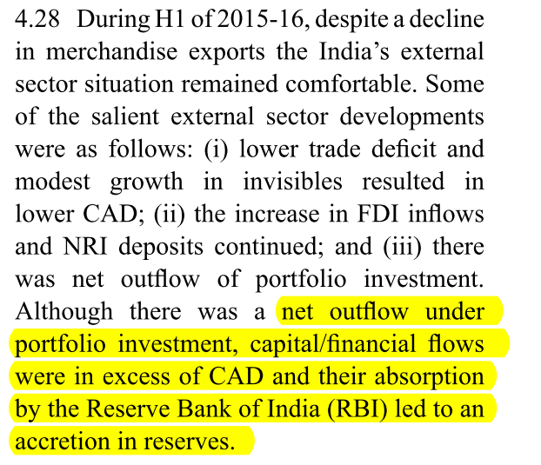
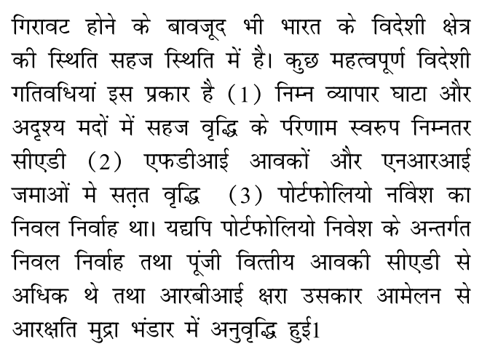
Summary of BoP development
Observe last slides again

Slide 56
India’s forex reserve consists of
Foreign currency
Gold
SDR
Reverse Tranche position
Held in Foreign treasure Bonds- most preferred US
1st largest China (1.25 trillion)
12th largest holder India (130bn)
Notes:
A certain proportion of a member country's quota is specified as its reserve tranche. The member country can access its reserve tranche funds at its discretion, and is not under an immediate obligation to repay those funds to the IMF. Member nation reserve tranches are typically 25% of the member's quota.

Slide 57
India’s Forex Reserve
Rises
Valuation
Capital inflow >> CAD =RBI intervention (buying $)
Declines
By Valuation
By RBI intervention (selling $)

Slide 58
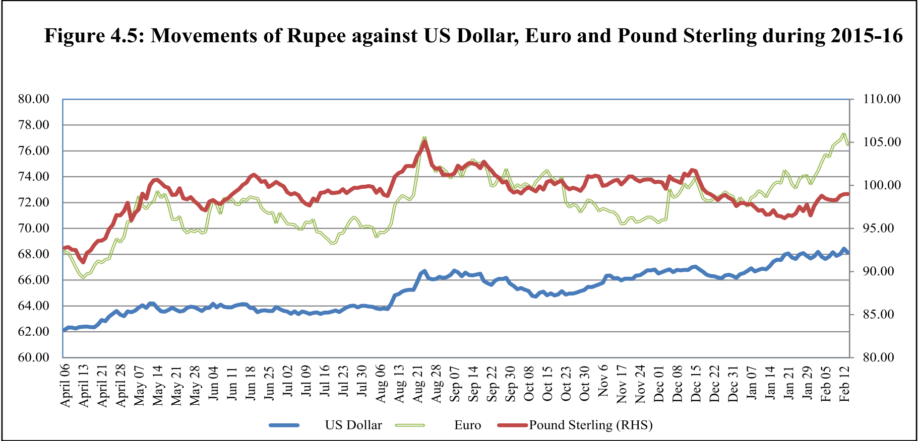
Exchange Rate regimes self study L3/P2
China crash, investors exit from EMDE
So, $$ getting strong against others
Notes:
emerging market and developing
economies (EMDE) owing to risk aversion
perceptions of global investors.

Slide 59
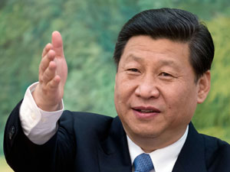
India vs. others
Exchange rate regimes
China, Japan and Korea business enterprises grew via an undervalued exchange rate. (HOW= SELF STUDY L6/P7)
But later on paid negative consequences.
RBI does not manipulate the exchange rate up or down
But intervenes in the situation of extreme volatility

Slide 60
Survey 2015
(A) Real effective exchange rate (REER) is better indicator of export competitiveness than nominal exchange rate.
(R) REER takes into account the level of inflation differences across countries and nominal exchange rates of partners.
Both right, “R” explains “A”. Ref: v2c4 page84
Self Study L3/P2

Slide 61
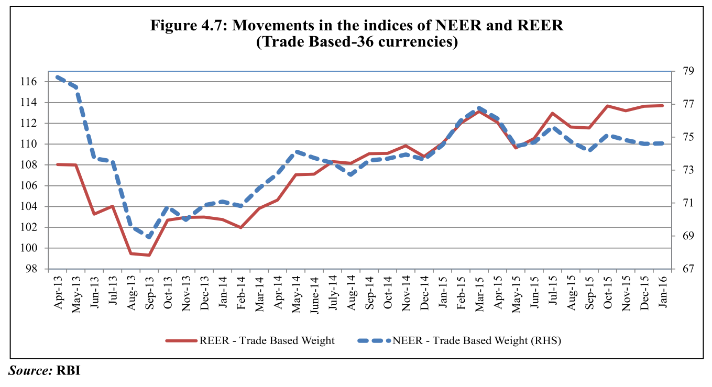
REER wise, Indian Rupee has appreciated
Good for importers
Bad for exporters

Slide 62

As liquidity increase, rupee weakens.
Last year RBI cut Repo by 125 basis points

Slide 63

Across the globe
Outflow / Exit of Foreign investors
Easy money Policy
Easy money Policy
Cheap money policy
Dovish money policy
Tight money policy
Dear Money
Hawkish
Easy money Policy
Easy money Policy
Good for exporters
Bad for importers
Govts. In dilemma over taxation polices
Easy money Policy
Notes:
spillovers of subdued global growth to other economies through trade channels and weaker commodity prices is manifest in diminishing confidence and increasing volatility in financial markets
. In addition, a dual monetary policy--a gradual tightening in monetary policy in the US in the backdrop of its resilient recovery and easy monetary policy in several other major advanced economies- -has led to continued uncertainties and poses challenges for the year ahead.

Slide 64
Rajan Paper ‘Rules of Monetary Policy’
Green
positive effects on both home and foreign countries
Orange
Red
Bitter pill, use temporary with care
Benefits domestic economy
But gravely endangers global economy
Must Avoid
Stop finger pointing
Update IMF Articles of association
Notes:
Paper with Prachi Mishra

Slide 65


Helicopter Money
IF Government drops money from helicopter to restart economy
Milton Friedman
US Economist

Slide 66

Sovereign debt & QE
OMO: Sale/Purchase to combat inflation/deflation
AUCTION
REPURCHASE to ▲liquidity & demand during slowdown =Quantitative Easing

Slide 67
Helicopter Money: rough mechanics
AUCTION
Central Bank buys & destroys bonds
“rain” of “NEW” money through wages, infra. dev, subsidies etc.
Notes:
Write off

Slide 68

Why in news? ECB’s Mario Draghi interested
Inflation
More Background: L3/P4: ECB quantitative easing & Greece Anti-Austerity

Slide 69
Fast Revision + Survey 2015: v2c4, v1c8
BoP #; ECB
Gold Schemes
IMF Reforms
WTO Nairobi
Mauritius DTAA
E-Commerce

Slide 70
Current Account DEFICIT
चालू खाता घाटा
TRADE DEFICIT
2015-Apr-Sept.
2015-Apr-Sept.

Slide 71


RBI’s ECB Framework 2015
Maturity Period
Rs: 5 years
Foreign currency: 10 years
Eligible borrowers
all except negative list i.e. Real estate, capital markets etc.(Small list)
Eligible Lenders
Regulated financial institutions, sovereign wealth funds, pension funds, insurance companies, etc.
Notes:
Rate- @prevailing market conditions

Slide 72

ECB: Repayment & Taxation
5% withholding tax on income from bonds
CGT exempt on
Exchange rate fluctuation
Notes:
Rate- @prevailing market conditions

Slide 73
Company finance: IFC Bonds
Intl. Finance Corporation (IFC), World Bank
Masala Bonds
Offshore rupee bonds
15 years tenure
Rs.110 billion worth bonds sold
11 pvt cos in India given finance
Maharaja Bonds
Issued within India's domestic Capital market
Rupee denominated
Tenure: 5 years, 10 years
Interest usually less than Indian Government bonds, since credit rating is higher (AAA)

Slide 74

Majority dollar denominated
Majority here

Slide 75
World Bank International Debt Statistics 2016
India is fourth lowest in the world
Debt to GNI: 22.7%
Debt to GDP: 23.7%;
Total Foreign Debt: ~$480 Bn
India is fifth best in the world
RBI sufficient forex to cover ~75% of debt
Notes:
When we say fundamental of economy are strong.

Slide 76
Fast Revision + Survey 2015: v2c4, v1c8
BoP #; ECB
Gold Schemes
IMF Reforms
WTO Nairobi
Mauritius DTAA
E-Commerce

